Slide 1
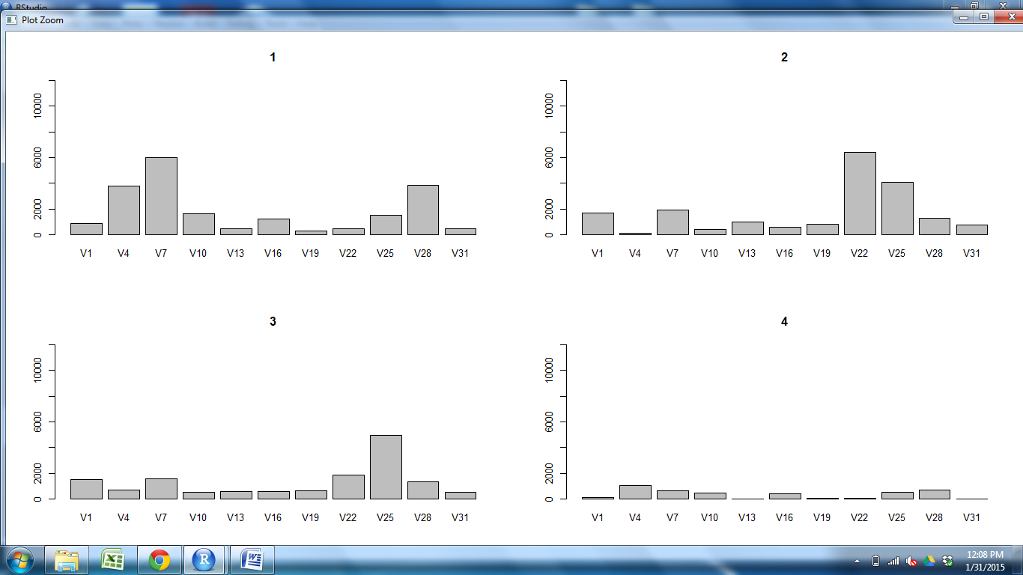
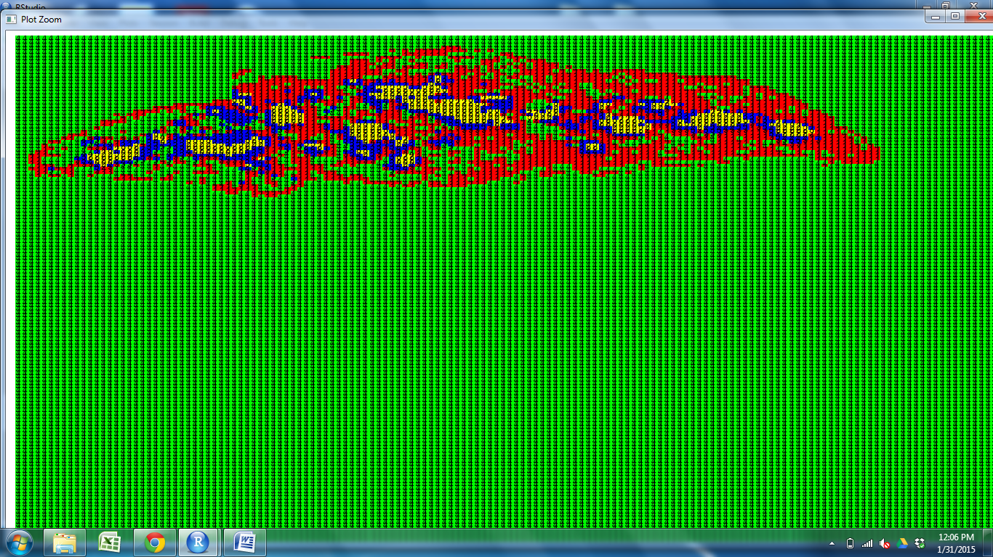
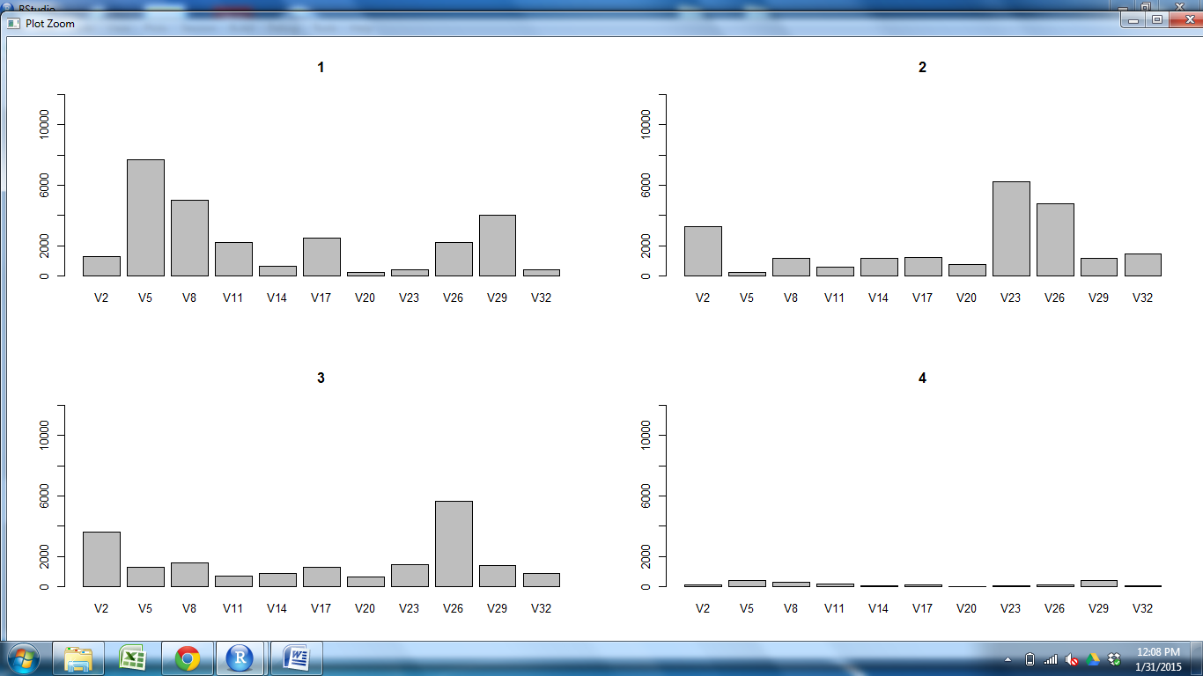
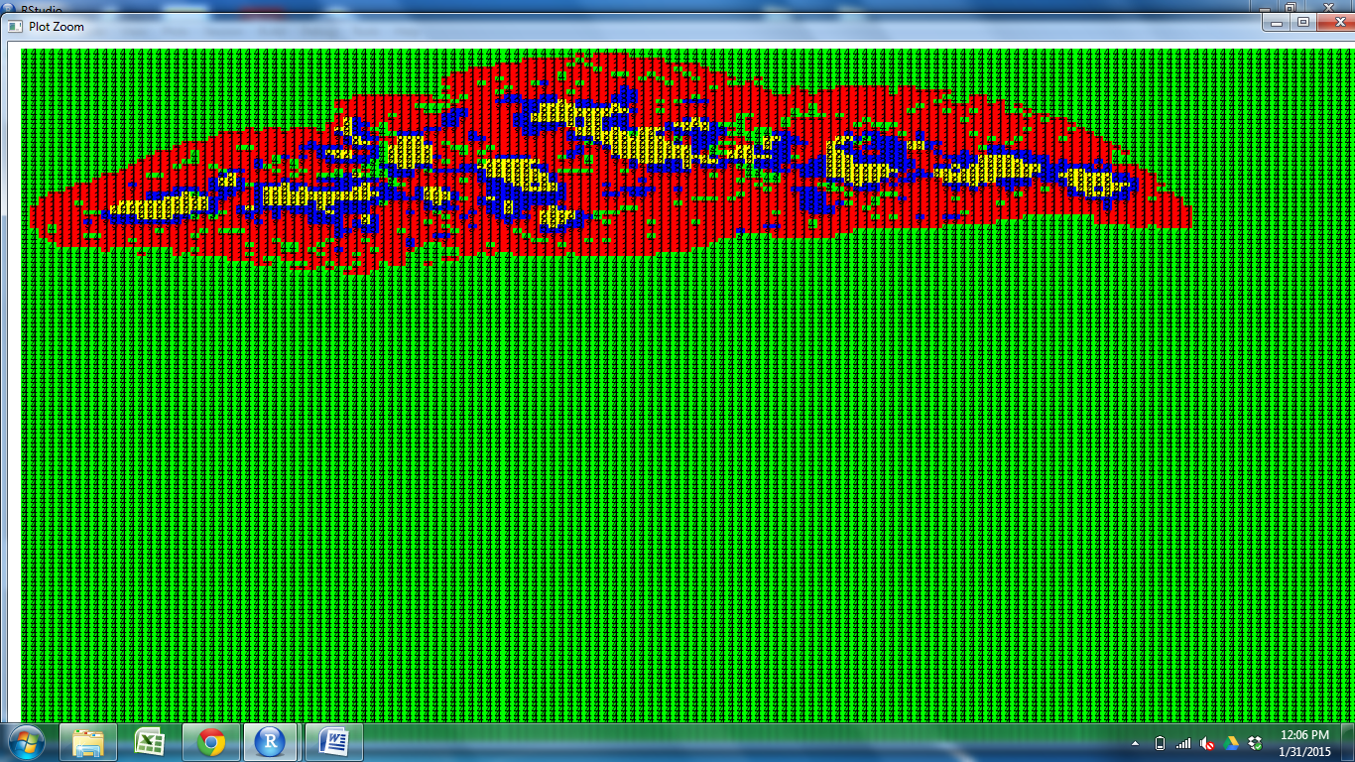
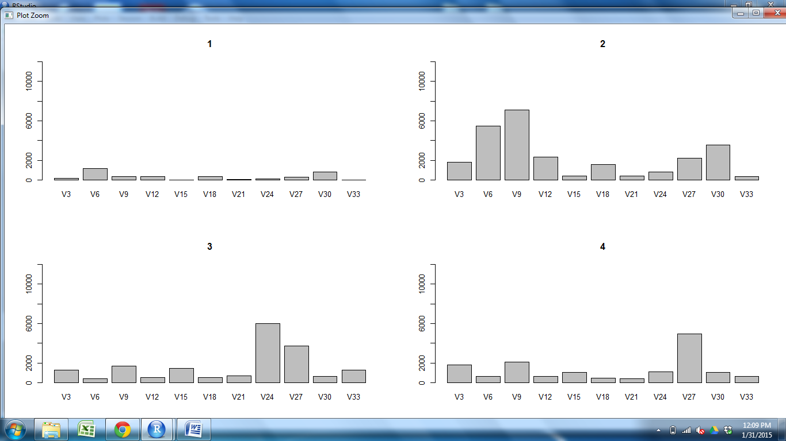
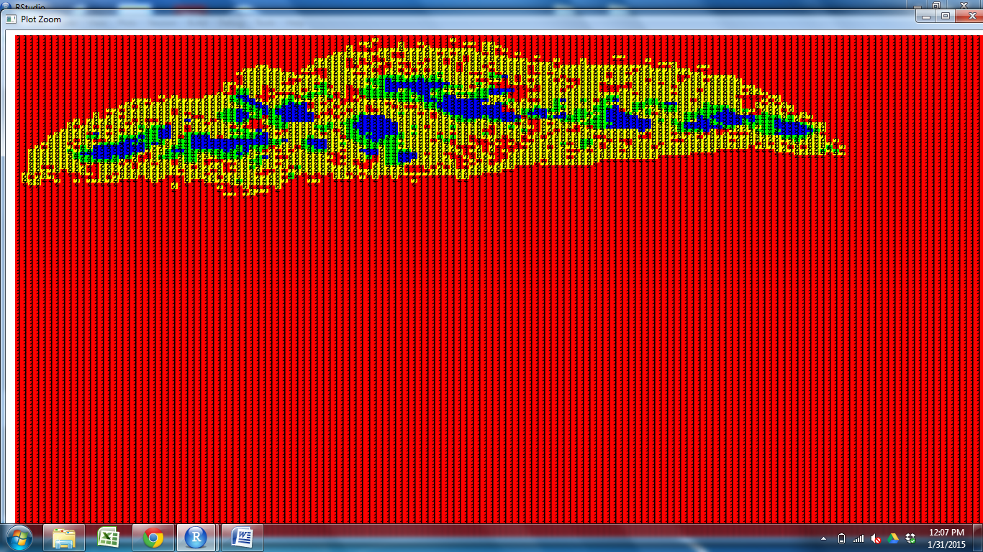
CD11c CD25 CD31 CD205 Claud5 Claud34 Foxp3 K5 K14 PDGFRb UEA1

Slide 2
CD11c CD25 CD31 CD205 Claud5 Claud34 Foxp3 K5 K14 PDGFRb UEA1

Slide 3
CD11c CD25 CD31 CD205 Claud5 Claud34 Foxp3 K5 K14 PDGFRb UEA1

Slide 4
CD11c CD25 CD31 CD205 Claud5 Claud34 Foxp3 K5 K14 PDGFRb UEA1

Slide 5
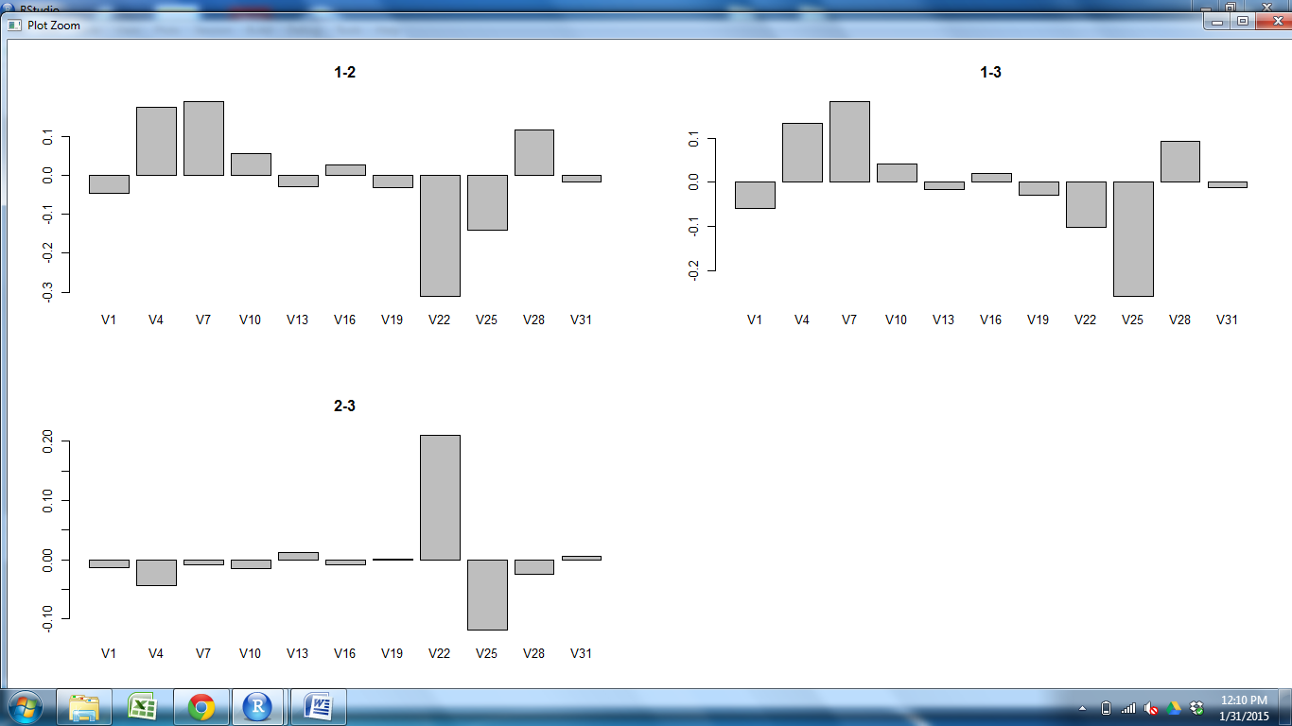
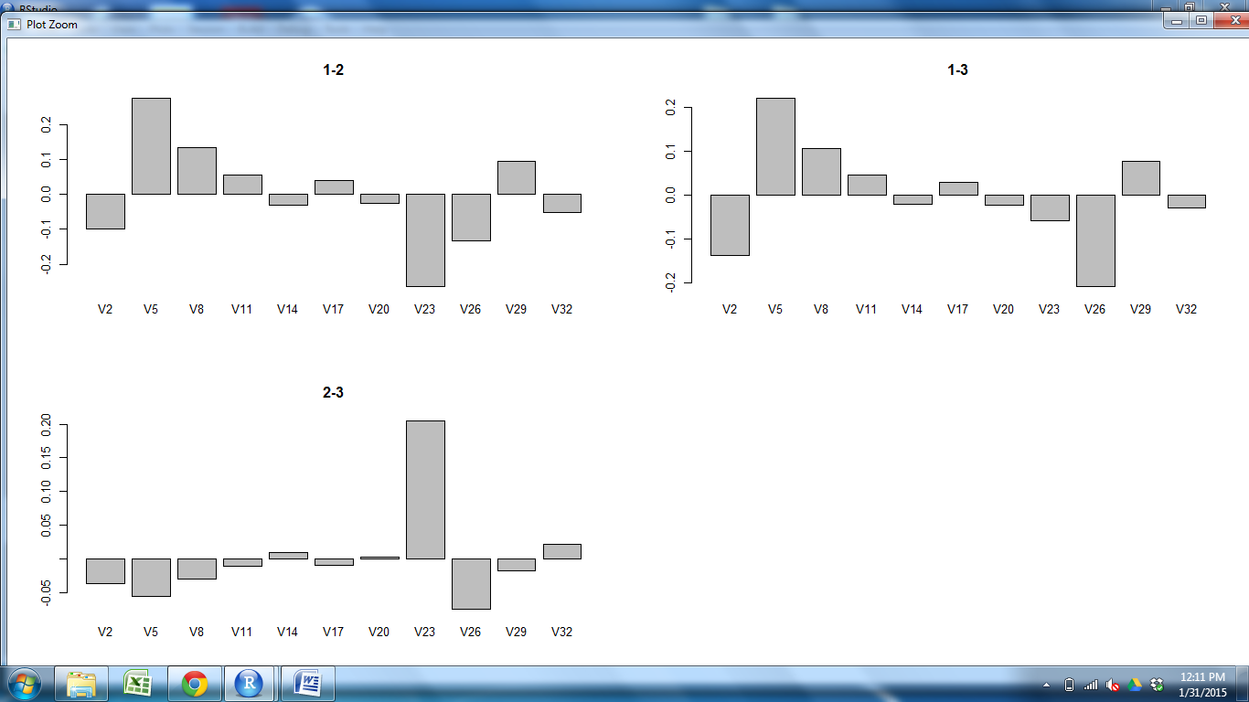
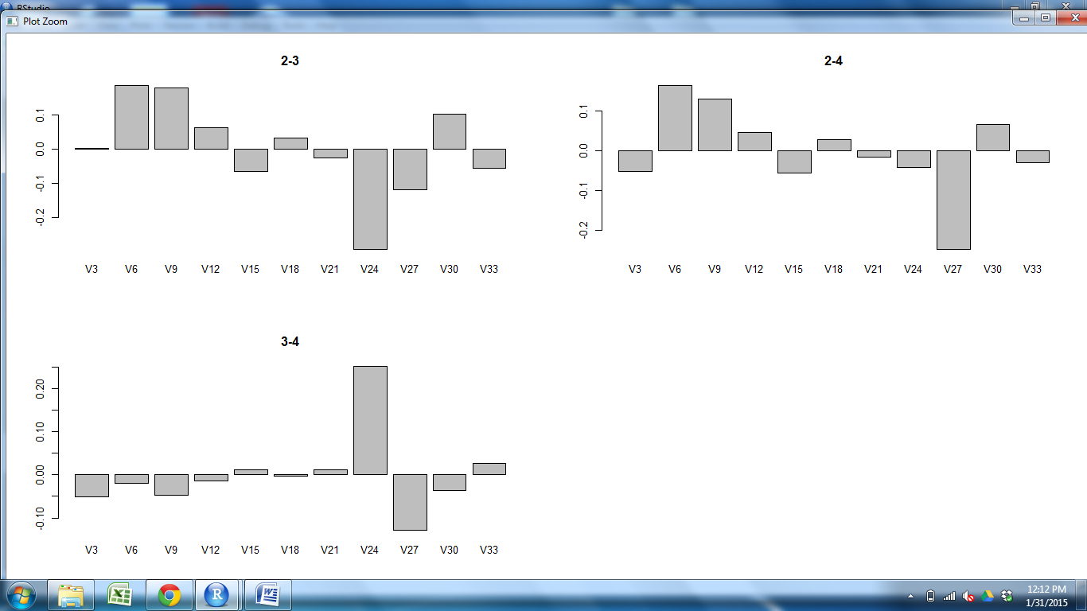
CD11c CD25 CD31 CD205 Claud5 Claud34 Foxp3 K5 K14 PDGFRb UEA1

Slide 6
CD11c CD25 CD31 CD205 Claud5 Claud34 Foxp3 K5 K14 PDGFRb UEA1

Slide 7
CD11c CD25 CD31 CD205 Claud5 Claud34 Foxp3 K5 K14 PDGFRb UEA1

Slide 8
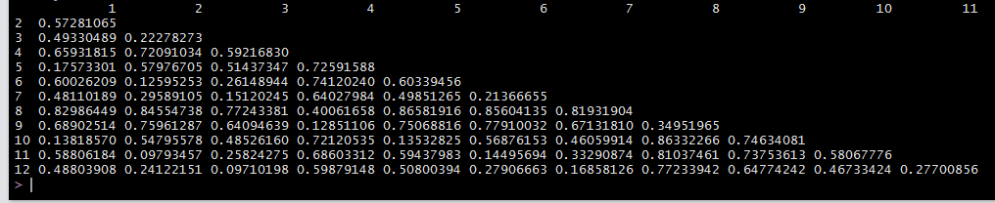
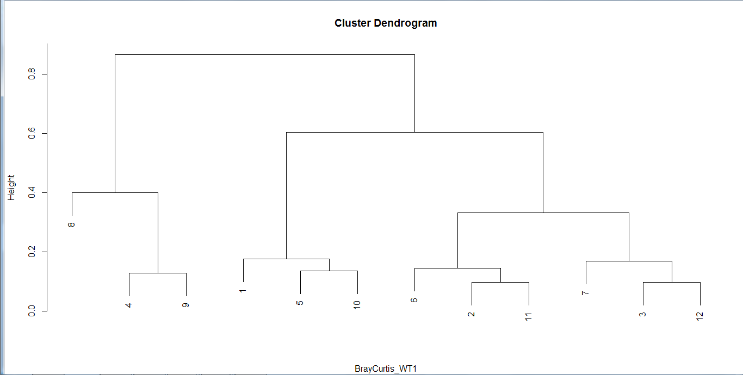
Cortex M2 M1 Outer Cortex M2 M1 Outer Outer Cortex M2
M2
M1
Outer
Cortex
M2
M1
Outer
Outer
Cortex
M2
M1
S2Outer S1Outer S3Outer S1Cortex S2Cortex S3Cortex S2M2 S1M2 S3M2 S2M1 S1M1 S3M1

